Slide 1
Citation Provenance
FYP Presentation
Heng Low Wee
19 Nov 2012

Slide 2
Citations in research papers give credit and uphold intellectual property

Slide 3
Citations refer to cited document for information. Problem?
Most citations are mere mentions
Even if referring to claims specifically, it is not immediately clear where is this information in the cited document

Slide 4
Difficult to find the exact text in the cited paper to justify the citation
Citation usually don’t include position of the information in the cited article…

Slide 5
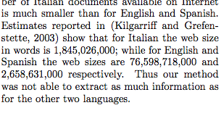

Slide 6
What is Citation Provenance?

Slide 7
Task: To locate the information in the cited paper that justifies the citation

Slide 8
Aim: To identify which section or paragraph in the cited paper is the cited information

Slide 9
Outline
Introduction
Related Work
Problem Analysis
Approach
Evaluation
Discussion & Conclusion

Slide 10
Related Work

Slide 11
Citation Classification
To classify citations into pre-defined classes so as to determine the rationale for citing
12-class annotation scheme [Teufel et al, 2009]
Citances (Citing context) [<citation>]
Automatic citation classification
Features from citances
Cue words/phrases

Slide 12
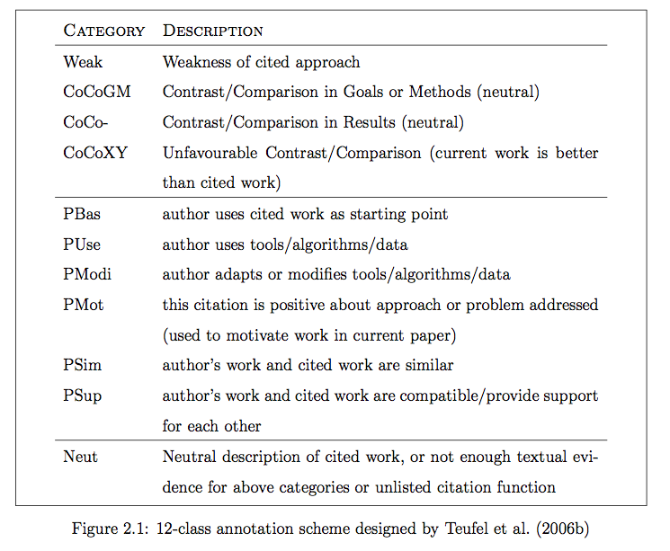

Slide 13
Content-Sensitive In-Browser Summariser (CSIBS)
Conducted series of survey
Difficult to find exact text that justifies citation
Citation does not include position of origin
Literature browsing; Summarisation tool
Displays preview of cited document; Highlight content-sensitive keywords

Slide 14
Sentence Alignment / Paraphrase
Nelken & Sheiber, 2006 presented a novel algorithm that produced great precision at aligning sentences in monolingual corpora
Shinyama et al, 2002 worked on automatic paraphrase extraction from news article

Slide 15
Related Work - Summary
Citation-related tasks require extracting features from citing context
There is demand for a reading tool that answers readers’ doubt – where is the origin of the citation?
A need to handle paraphrasing that is common when making citations

Slide 16
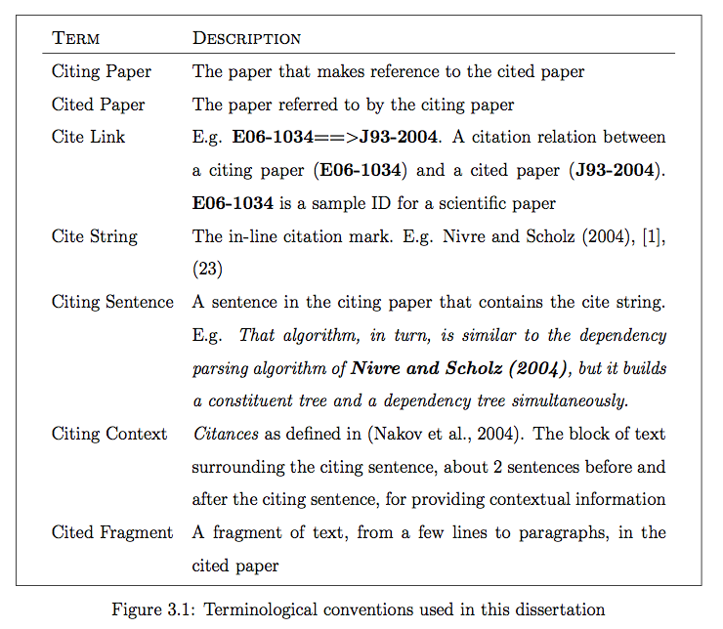
Terminology

Slide 17
Problem Analysis

Slide 18
Problems (Recap)
Most citation are only mentions
Even if specifically referring to claims, not immediately clear where this info is in the cited document
Difficult to find the info that justifies the citation
Citation usually don’t include position of info in the cited article

Slide 19
Is the citation a mere mention?
What is a mention? What is not?
How to tell whether it is just a mention or not?
If it is referring to specific information, how do we locate it in the cited paper?

Slide 20
General vs Specific

Slide 21
General
Authors may refer to paper…
as a whole. If author cites for a key idea, e.g. Machine Learning, and this idea makes up the entire paper
just to mention it. Give credit; acknowledgement

Slide 22
Specific
Authors may refer to paper…
For Term definitions
Key idea/implementation. It does not make up the entire paper
Algorithm/Theorem. It does not make up the entire paper
Digits/numerical figures. E.g. refer to evaluation results. To complement performance

Slide 23
Scope of the Problem

Slide 24
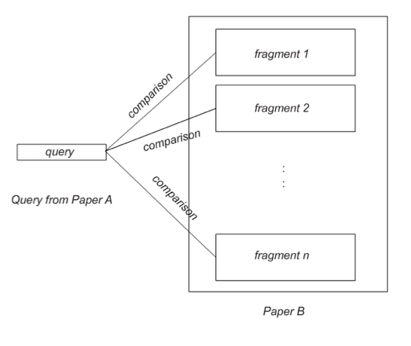
Modeling Our Problem

Slide 25
Target Corpus
ACL-Anthology Reference Corpus (ACL-ARC)
Computational Linguistic papers
Interlink data
E.g. X98-1031==>X96-1049
Citation relationships
Just a start; Aim to eventually generalize to all fields of research

Slide 26
What data do we need?
Which paper cites which paper? Paper A cites Paper B?
Cite link. E.g. X98-1031==>X96-1049
Contextual information? We need more information than just the cite string (E.g. [1], Nelken & Sheiber, 2006)
Citances / Citing context
Paper A might cite Paper B multiple times, hence multiple citing contexts
Where is the cited information?

Slide 27
Collecting Annotation – 1st Attempt

Slide 28
Collecting Annotation – 2nd Attempt

Slide 29
Approach

Slide 30
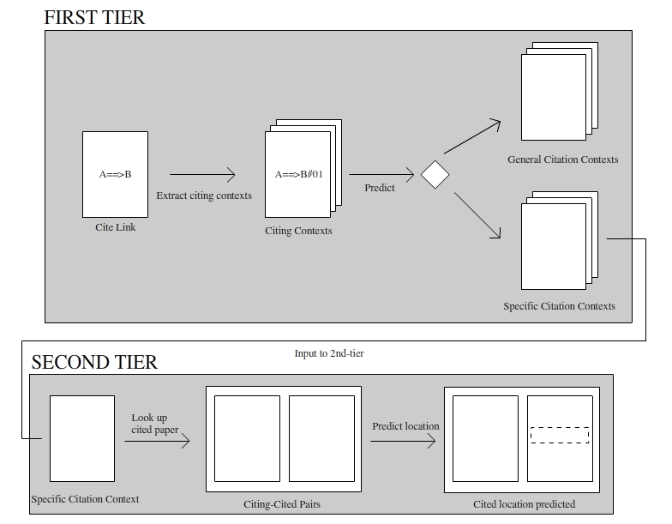
Two-tier Approach

Slide 31
GvS (1st tier)

Slide 32
LocateProv (2nd tier)

Slide 33
Evaluation

Slide 34
Evaluating GvS

Slide 35
Evaluating LocateProv

Slide 36
Discussion

Slide 37
Conclusion

Slide 38
Thank You

